Slide 1

Use of Intelligent Solar Panels to Facilitate Carbon Trading
Gichira Alvin Kaburu
P15/1553/2015

Slide 2



Introduction

Slide 3
Introduction
Intelligent solar panels are solar panels that have solar tracking, data collection and transmission ability.
Data transmitted is energy, power and geographical data.

Slide 4
Introduction
Carbon Trading a system by which countries and organizations receive permits to produce a specified amount of carbon dioxide and other greenhouse gases.
Permits are based on carbon credits. The higher the credits, the higher the allowance to produce Green House Gases (GHGs).
Credits are purchased by countries/organizations of high GHGs emission from countries/organization of low GHGs emission.

Slide 5
Background
The money is used to create and maintain methods that can reduce emission of Green House Gases.
The concept of carbon trading was developed in the Kyoto Protocol in 1997. 128 countries are bound by it.

Slide 6
Problem Statement

Slide 7
Problem Statement
Solar panels, should be intelligent enough to collect the maximum amount of energy and power data from the environment so as to facilitate carbon trading between private owners, companies and governments.

Slide 8
Objectives

Slide 9
Research Objectives
The goal of this project is to determine a method in which companies and individuals can benefit from carbon trading through use of an intelligent single axis solar panel with the ability to collect and transmit data from the environment.

Slide 10
System Objectives
To modify an existing solar panel by adding the ability to collect and transmit data from its owners while following the sun.
To use the data collected to calculate extra carbon credits sold through the carbon market.
To facilitate financial benefit to individuals and body corporates through the sale of carbon credits.
To analyze the collected data and come up with information that can be used to improve business processes.

Slide 11
Justification

Slide 12
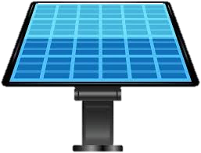




Customers Earn KES 9,634.25/year
30%
20
0.705 kg
1200/=
More Electricity
Panel System
Of Co₂ /KWH generated
Carbon Credit Cost
1.2 kwh to 1.56 kwh
569.4 kwh by 20
11,388 kwh by 0.705
8.02854 T by 1200
569.4 kwh/year
11,388 kwh/year
8.02854 Tons of CO₂
KES 9,634.25/year

Slide 13
Literature Review

Slide 14
Introduction
In Kenya, companies like Mumias Sugar, KenGEN, Standard Group and East African Portland cement have participated in the trade earning millions.
The NSE is currently considering to recognize carbon trading as an exchangeable security.
Since solar energy is a carbon neutral energy source, it qualifies as an earner of carbon credits.

Slide 15
Existing Solutions

Slide 16
Existing Solutions
The largest single axis tracker project in Asia, generating 172MW of energy. The project is controlled and managed by Arctech Solar company.
NEXTracker company projects to install solar trackers on behalf of customers on demand. The company also manages and maintains the solar trackers to ensure they remain efficient and effective.

Slide 17
Proposed Solution

Slide 18
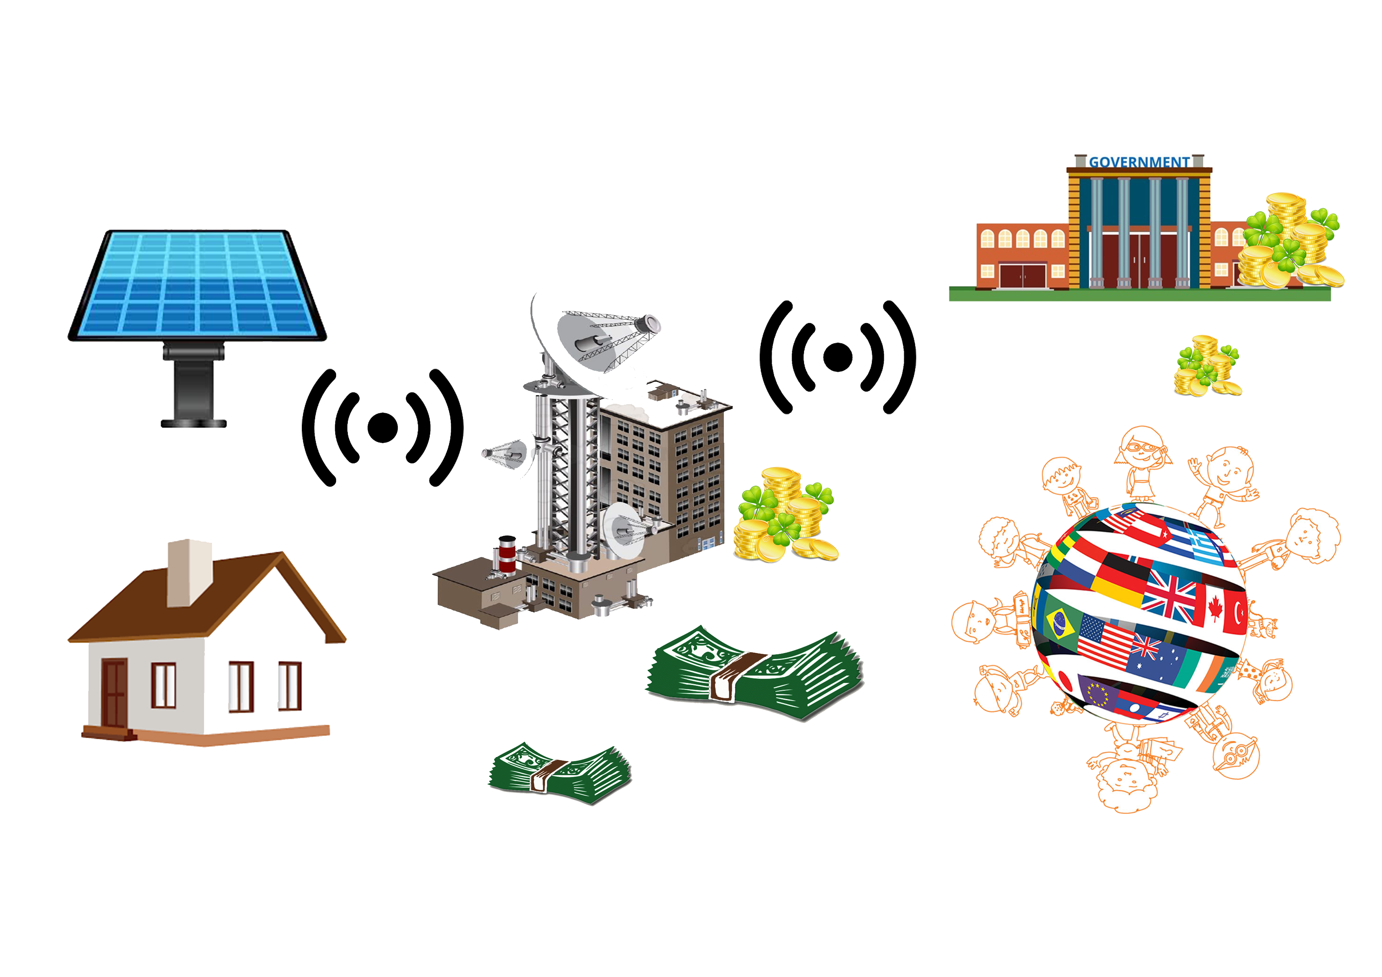
Proposed Solutions

Slide 19
Resources Required
The following are the major resources required:
Micro controller
Solar Panel
GSM/Wi-Fi Module
Servo Mortar
Software – Hardware interfacing Protocols
Voltage and Current Sensors

Slide 20
Methodology

Slide 21
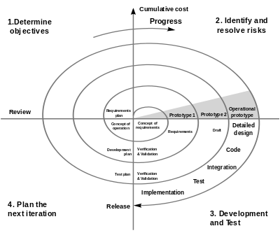
Spiral Model of Development
Reasons for this Methodology
Need for iterations
Need to take in clients views
The project is a medium to high-risk project.
Long term in nature

Slide 22
Schedule and Budget

Slide 23
ID | Task Name | Feb | Mar | Apr |  | May | June |  | Jul | Aug |  | Sept | Oct
1 | Research
2 | Planning
3 | Testing of Alternatives
4 | Choice Implementation plan and Design
5 | Assembling of Hardware Components
6 | Testing of Hardware components
7 | Software components design
8 | Testing of Software components
9 | Overall Testing
10 | Review
11 | Documentation

Slide 24
 | KSH | KSH
Total Income |  | 0
Expenses
Simple 6V 2A Solar Panel | 1000
2M PPR Pipes | 250
24 x 24 Inches Wood Board | 250
Arduino Mega 2560 Rev3 | 2500
ESP8266 Node MCU | 800
DHT22 Sensor | 200
20 Pieces Resistors | 80
5 Pieces Light Dependent Resistors | 15
50 Pieces Male to Male Jumper Wires | 200
50 pieces Male to Female Jumper Wires | 200
I2C LCD Display | 500
10 Pieces LEDs | 30
Active and Passive Buzzer | 100
Total Expenses |  | 6125

Slide 25
References
Lavine. (2013). The future of renewable energy 1st Edition, New York: Thorn bird, pp. 55-70.
S. Abdallah (2017). Design of Energy Efficient Sensors, 13(3-4), 147-148.
F. Dawned (2014). Design of the linkages type tracking mechanisms of the solar energy conversion systems by using Multi Body Systems Method, 54-58.
IEA (2014). IEA report Technology Roadmap: Solar Photovoltaic Energy.
ERC (2012). Solar Energy. Retrieved from http://renewableenergy.go.ke/index.php/content/31
P. Alushula (2016). Government to support NSE introduce carbon credits trading. Retrieved from https://www.standardmedia.co.ke/business/article/2000208079/government-to-support-nse-introduce-carbon-credits-trading

Slide 26
Use of Intelligent Solar Panels to Facilitate Carbon Trading
The End

